Slide 1
Chest imaging
Lecture one
Dr. Marwa Majid aladhab
Mbchb, fibms

Slide 2
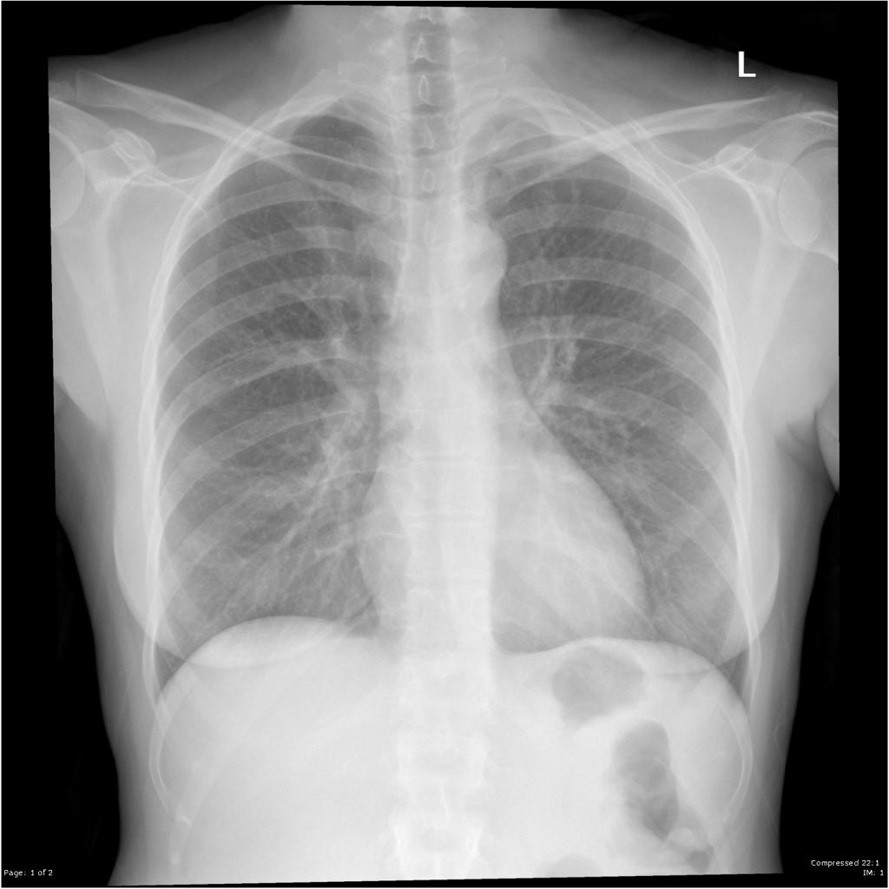
Case
45-years-old female presents with left scapular pain and cough. As part of the GP's initial work up for the patient presentation, a chest x-ray was obtained.
What are the next imaging investigations?

Slide 3
Objectives
Methods of investigation
Chest x ray: -projections
- technical assessment
- diagnostic assessment

Slide 4
Common imaging modalities
Chest X ray (CXR)
CT scan
MRI
PET
Thoracic Ultrasound
Ventilation/perfusion lung scanning

Slide 5
CXR
Is requested for virtually all patients with respiratory symptoms
Projections performed:
Posteroanterior view (PA)
Lateral view
Other: Anteroposterior (AP)/ supine CXR
expiratory film
Decubitus view
Oblique view

Slide 6
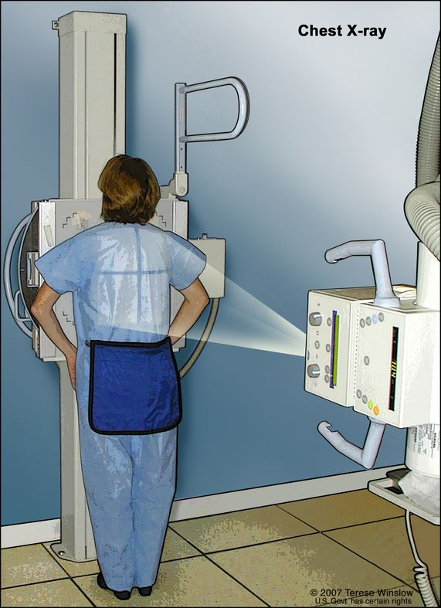
PA erect CXR
Reasons for performing the film PA:
Accurate assessment of cardiac size due to minimal magnification
Scapulae able to be rotated out of the way
Notes:
Distance 72 inch

Slide 7
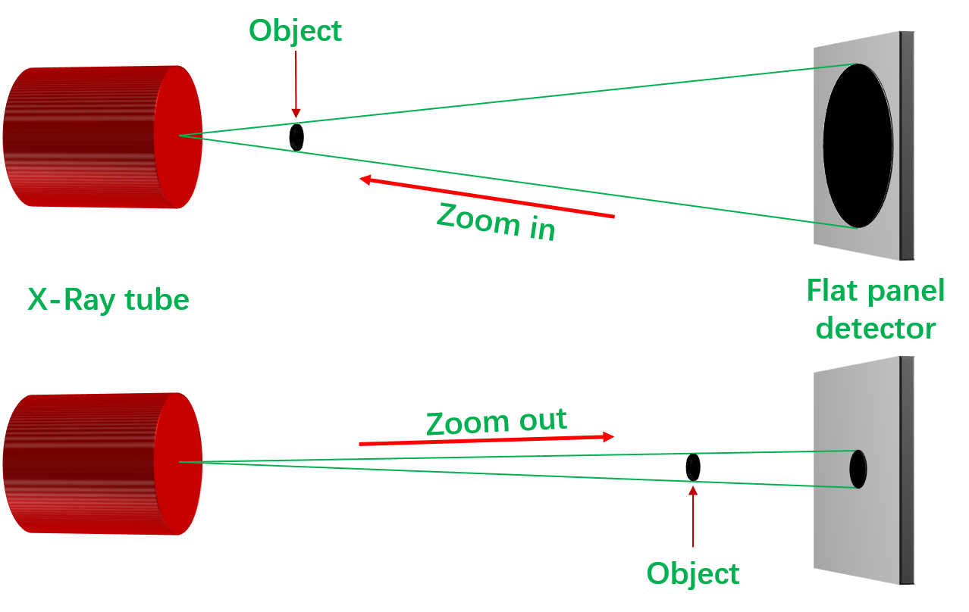

Slide 8
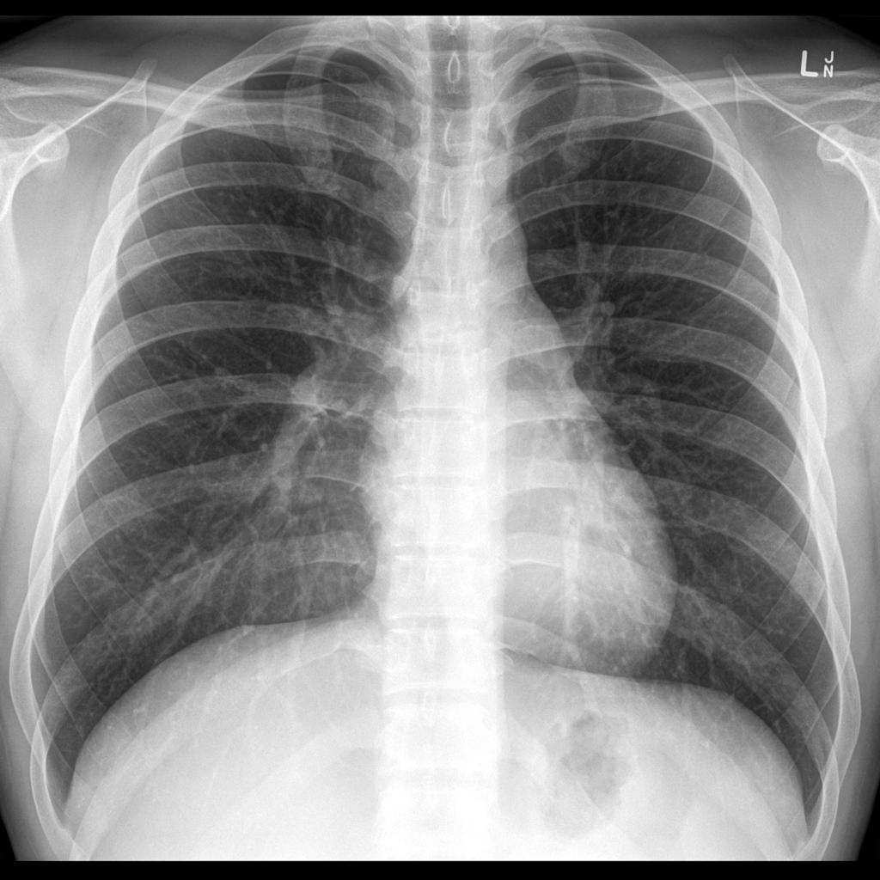
PA erect CXR
Reasons for performing the film erect:
Physiological representation of blood vessels of mediastinum and lung.
Gas passes upwards.
Fluid passes downwards.
Notes:
pneumothorax is more easily diagnosed, as is free gas beneath the diaphragm
pleural effusion is more easily diagnosed.

Slide 9
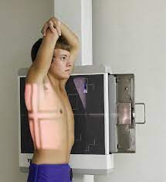
Lateral CXR
Reasons for performing a lateral CXR:
Further view of lungs, especially those areas obscured on the PA film.
Further assessment of cardiac configuration
Further anatomical localization of lesions.
More sensitive for pleural effusions
Good view of thoracic spine.
Notes:
e.g. posterior segments of lower lobes, areas behind the hila, left lower lobe, which lies behind the heart on the PA

Slide 11
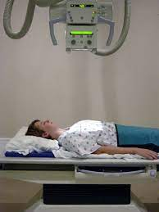
Other projections
Supine (AP CXR):
Acutely ill or traumatized patients, and patients in ICU or CCU (portable X ray)
Mediastinum and heart appear wider due to venous distension and magnification.

Slide 12
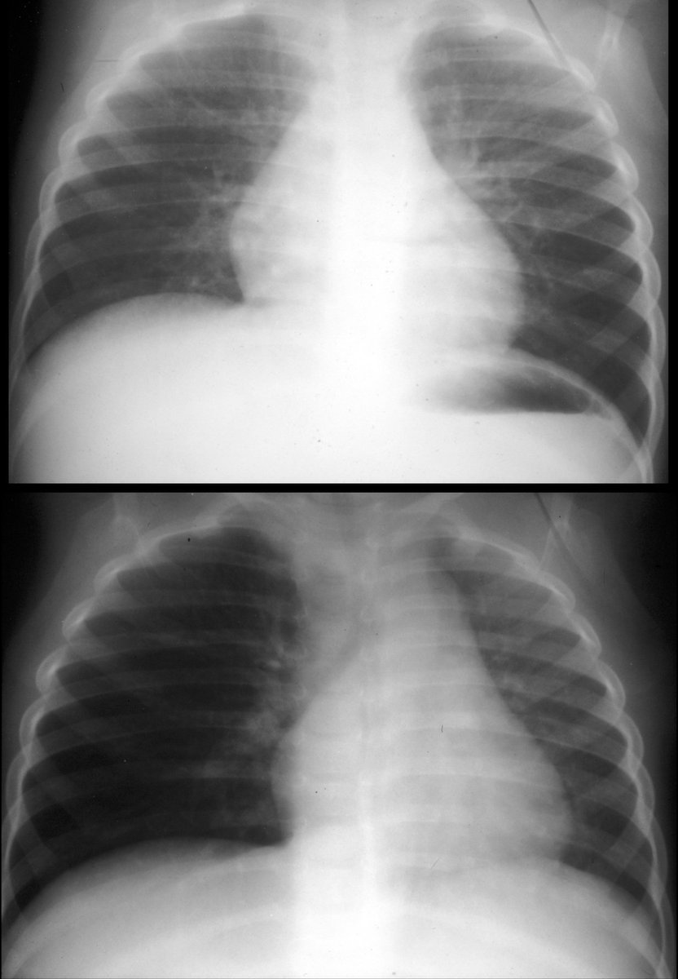
Expiratory film:
Increased sensitivity for small pneumothorax.
Suspected bronchial obstruction with air trapping
Notes:
in expiration the lung is smaller while the pneumothorax does not change in volume
, e.g. inhaled foreign body in a child: in
expiration the normal lung reduces in volume while the lung with an obstructed airway remains inflated.

Slide 13
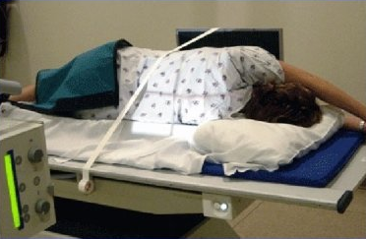
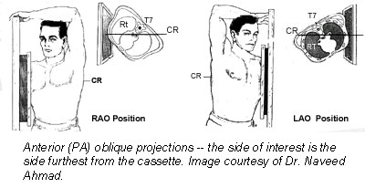
Decubitus film:
Radiograph performed with the patient lying on their side.
Used occasionally in patients too ill to stand where pleural effusion or pneumothorax are suspected and not definitely diagnosed on an AP film.
Oblique views:
may be used for suspected rib fracture, or to display other chest wall pathologies.

Slide 14
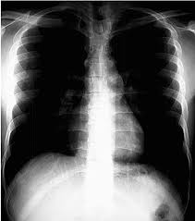

Slide 15
Technical assessment of CXR
Centering of the patient:
• With proper centering of the patient the lung apices and both costophrenic angles should be visualized.
Rotation:
• Rotation may cause anatomical distortion
• The easiest way to ensure that there is no rotation is to check that the spinous processes of the upper thoracic vertebrae lie midway between the medial ends of the clavicles.

Slide 16
Technical assessment of CXR (continuo)
Degree of inspiration:
• Inadequate inspiration may lead to over diagnosis of pulmonary opacity or collapse.
• With an adequate inspiration the diaphragms should lie at the level of the fifth or sixth ribs anteriorly, and in children trachea should be straight.
Orientation:
Check the left and right markings

Slide 17
Penetration:
Look at the lower part of the cardiac shadow, the vertebral bodies should only just be visible through the cardiac shadow.

Slide 19
Diagnostic assessment of CXR
Don’t forget the clinical context and the time course of any abnormality.
Scanning the PA film
1. lung fields: * equal transradiancy * try to identify the horizontal fissure and check its position *assess lung volume
*any discrete or generalized shadows
Notes:
Run from hilum to the 6th rib in axillary line

Slide 20
2. look at the hilum: *position *shape *size *density
3. look at the heart: * shape * cardiothoracic ratio (the maximum transverse diameter of the heart is less than the half of the transthoracic diameter at the broadest part of the chest) *abnormally dense areas
4. check rest of the mediastinum: *edge clear *abnormal widening *Rt paratracheal strip (< 2-3mm wide)
5. look at the trachea
Notes:
Left higher than right although the difference should be less than 2.5cm

Slide 21
6. look at the diaphragms: *Rt higher (difference <3cm) *outline smooth * level of highest point
7. look at costophrenic angle: *well defined acute angles.
8. look at the bones *follow outline for fracture *assess density
9. soft tissues
10. look at the area under the diaphragm

Slide 23
Scanning lateral film
1. lung fields: *compare density of the field in front of and above the heart to those behind * no discrete lesion.
2. look at the retrosternal space: *blackest part
3. check the position of horizontal and oblique fissures
4. density of the hila
5. appearance of diaphragms
6. look at the vertebral bodies: *get more translucent as one move caudally *same shape, size, density
Notes:
Horizontal fissure pass horizontally from mid hilum to anterior chest wall
Oblique run obliquely downward from T4/t5 vertebra through hilum ending at anterior third of diaphragm

Slide 24
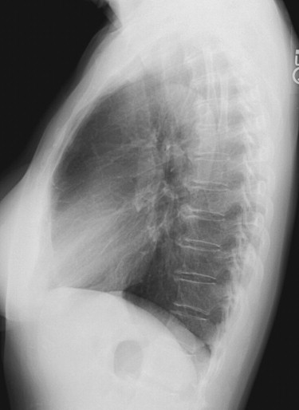

Slide 25
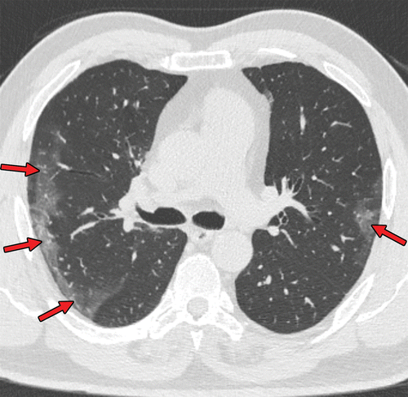
CT scan
Advantage: superior contrast resolution and cross-sectional display format.
uses:
• Further characterization of CXR findings
• As a primary investigation of chest disease (e.g. staging of lung cancer, detection of occult metastases)
• Procedure guidance
• HRCT
• CT pulmonary angiography (CTPA)
Notes:
The major advantages of CT are its superior contrast resolution and cross-sectional display format. Superior contrast resolution allows for the differentiation of calcium, soft tissue, and fat within lung nodules or mediastinal structures. Intravenous enhancement improves contrast within structures or masses, as well as within blood vessels (e.g., pulmonary emboli, aortic dissection). The cross-sectional display eliminates the superimposition of structures and allows visualization of parenchymal nodules as small as 2 mm.
HRCT technique involves incremental thinly collimated scans (1.0 to 1.5 mm) obtained at evenly spaced intervals through the thorax for the evaluation of diffuse bronchial or parenchymal lung disease. Image acquisition time is limited to minimize the effects of respiratory and cardiac motion

Slide 26
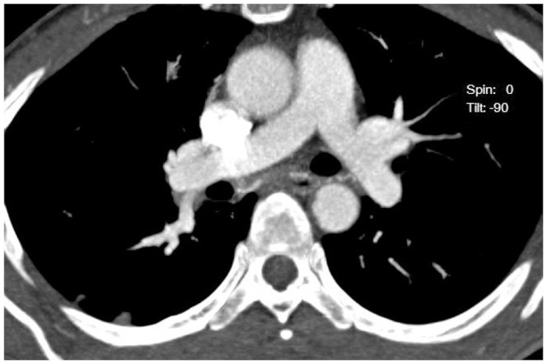
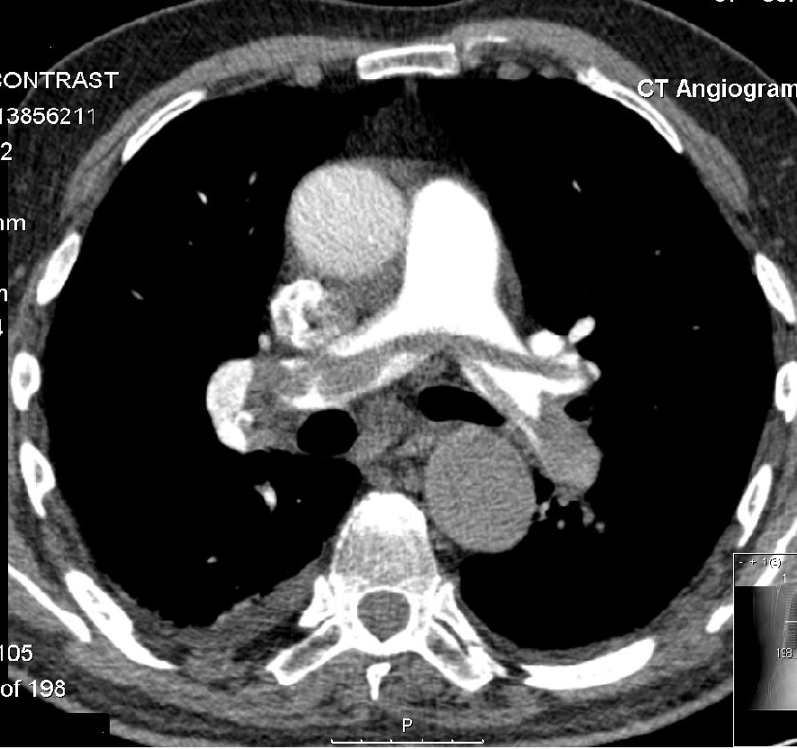
CT pulmonary angiography
The technique involves adequate enhancement of the pulmonary trunk and its branches.
Uses: Suspected pulmonary embolism: acute or chronic (based on the detection of filling defects in the pulmonary arterial vasculature).

Slide 27
MRI of the Thorax
Advantage: superior contrast resolution between tumor and fat, the ability to characterize tissues based on T1 and T2 relaxation times (e.g., cyst, fibrosis), the ability to scan in direct sagittal and coronal planes, fat suppressed sequences, and the lack of need for intravenous iodinated contrast, no radiation hazard.
Disadvantage: lengthy and costly exam, sensitive to respiratory motion and a cardiac pulsation artifact (need latest generation scanners, rapid single breath hold acquisitions or special respiratory gating and cardiac gating), less availability

Slide 28
Uses of MRI of the thorax
Evaluation of aortic disease in stable patients: Dissection, aneurysm, intramural hematoma, aortitis.
Assessment of superior sulcus tumors.
Evaluation of mediastinal, vascular, and chest wall invasion of lung cancer
Staging of lung cancer patients unable to receive intravenous iodinated contrast
Evaluation of posterior mediastinal masses

Slide 29
Positron emission tomography (PET)
PET utilizing fluorodeoxyglucose (FDG) is an imaging modality based on the metabolic activity of neoplastic and inflammatory tissues and therefore can be considered complementary to the anatomic information provided by chest radiography and CT
useful to characterize solitary pulmonary nodules where other imaging is unhelpful (thoracic PET)
whole-body PET in the evaluation of patients with malignancy, particularly bronchogenic carcinoma, for staging purpose

Slide 30
Ultrasound
Transthoracic US is now commonly used for the detection, characterization, and sampling of pleural, peripheral parenchymal, and mediastinal lesions .
Aspiration of small pleural effusions and sampling of visible pleural masses in patients with malignant effusions.
Large anterior mediastinal masses that have a broad area of contact with the parasternal chest wall may be biopsied without transgressing the lung.
Real-time US can also confirm phrenic nerve paralysis without the use of ionizing radiation.
It also easily detects subpulmonic and subphrenic fluid collections, which may cause diaphragmatic elevation.
Notes:
The aspiration of small pleural effusions visualized on real-time US is preferable to blind thoracentesis. Similarly, sampling of visible pleural masses in patients with malignant effusions can diminish the number of negative pleural biopsies.

Slide 31
Ventilation/perfusion lung scanning
Nuclear medicine examination utilized in the evaluation of non-cardiac thoracic disease.
V/Q scanning is used almost exclusively for the diagnosis of pulmonary embolism, although quantitative VQ imaging may be useful in the planning of bullectomy, lung volume reduction surgery for emphysema, and lung transplantation.

Slide 32
Case
45-years-old female presents with left scapular pain and cough. As part of the GP's initial work up for the patient presentation, a chest x-ray was obtained.
What are the next imaging investigations?

Slide 33
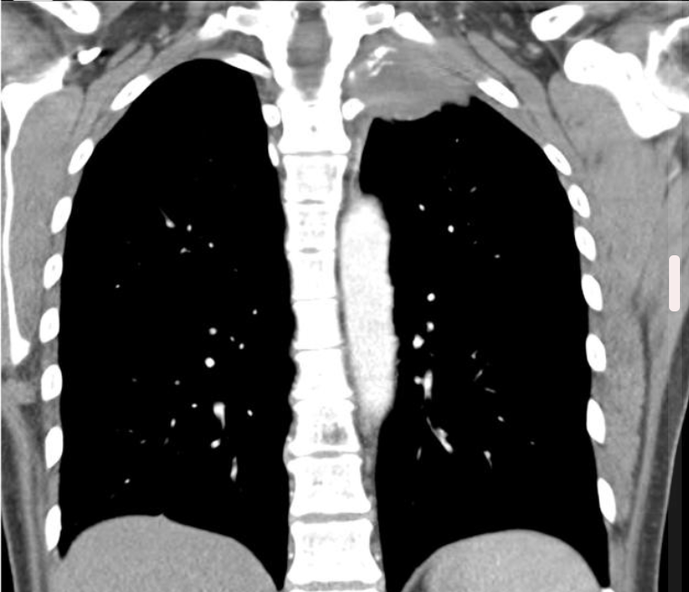
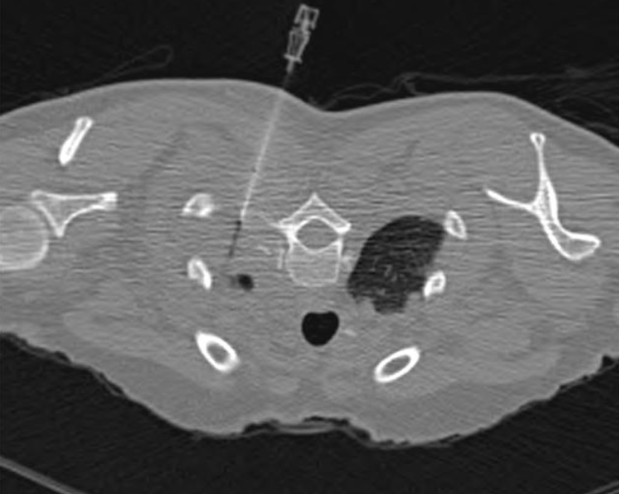

Slide 34
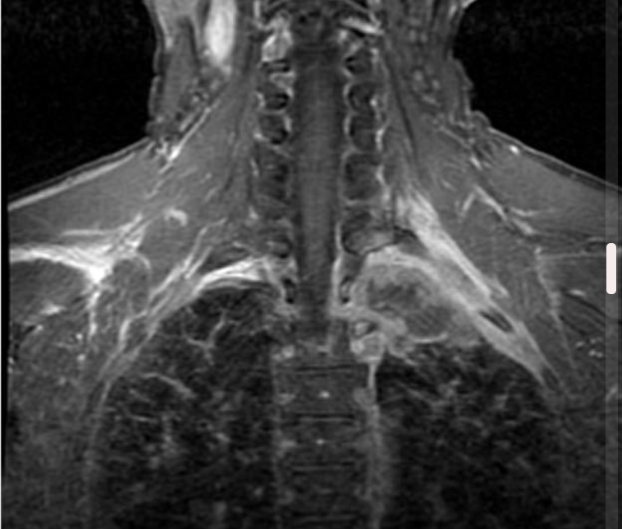
Histology: Left superior sulcus: Poorly differentiated squamous cell carcinoma.

Slide 35

Homework

Slide 36
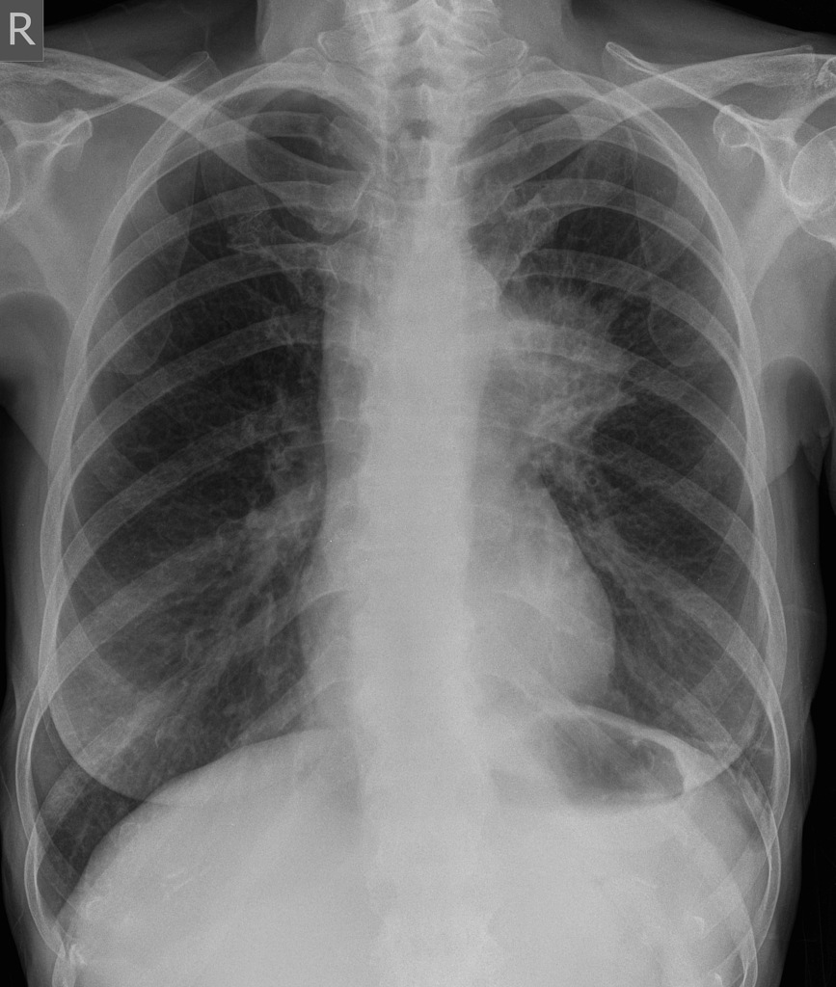
Case 1

Slide 37
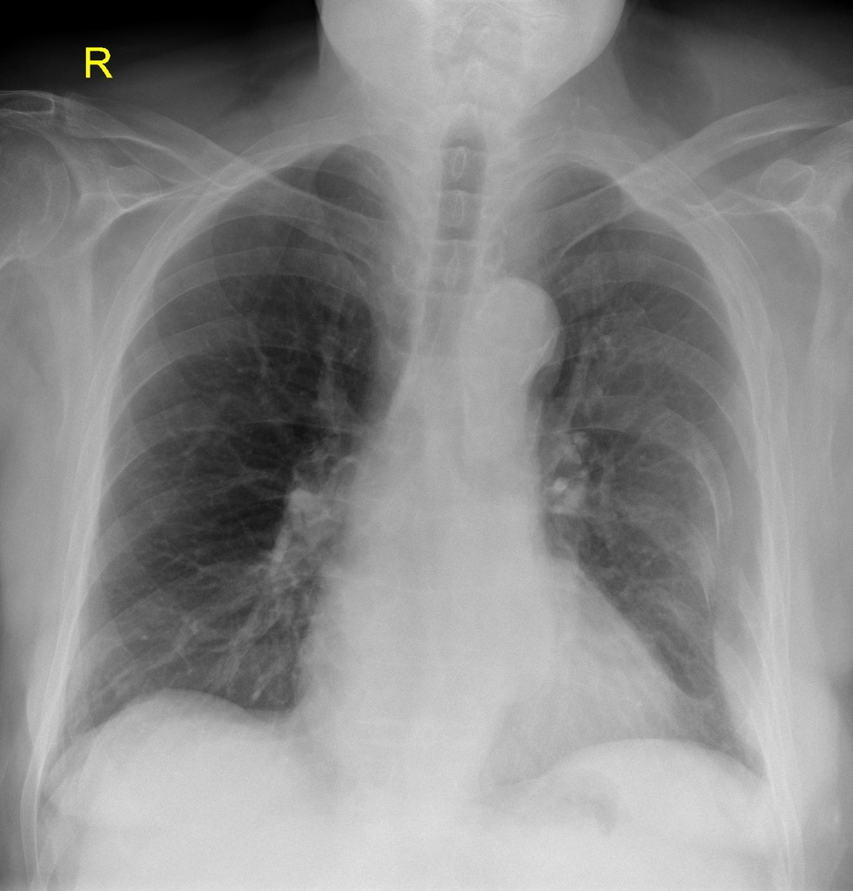
Case 2

Slide 38
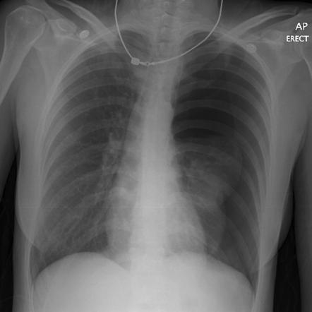
Case 3

Slide 39
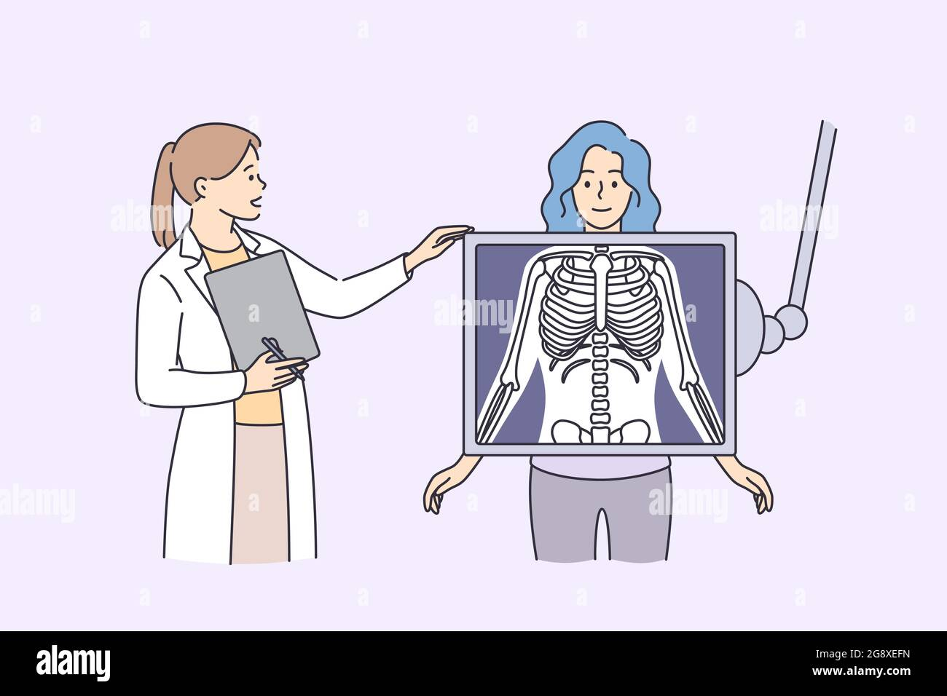
Thank you

